Slide 1

“E-COMMERCE WEBSITE”
Frontend Module

Slide 2
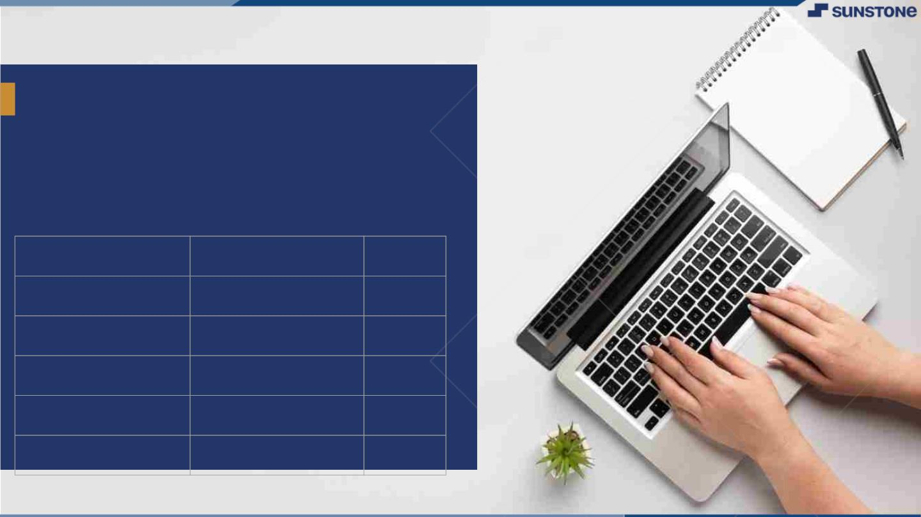
BOTIQUE WEBSITE
Introduction
Welcome to our Boutique, where style meets sophistication. Step into a world of fashion that reflect your unique personality and embraces timeless elegance. Discover a collection that blends contemporary trends with classic charm, ensuring you find pieces that resonate with your individual sense of style.
LMS Username
Name
Batch
AFREENA A
4
ASHIBA BEGAM M
4
DURGALAKSHMI V
4
SARULATHA S
4
SHARMILA B
4

Slide 3
UI Components
Dashboard Component : Visual representation of inventory metrics an data.
Product Management Component: Add, edit, and categorize products in the inventory.
Order Management Component: Handles purchase and sales orders.
User Management Component: Administers user roles and permissions.
Integrate the API to the frontend to ensure dynamic feature
Purpose and Role
Data Retrieval
Data Updates
Error Handling and Security
Documentation and Version
Implementation and Strategies

Slide 4
Learning Outcome
• The main purpose of inventory management is to help businesses easily and efficiently manage the ordering, stocking, storing, and using of inventory. By effectively managing your inventory, you’ll always know what items are in stock, how many of them there are, and where they are located.
• You can zero in on exactly what you need, what’s not so important, and what’s just a waste of money. That’s using inventory management to practice inventory control. By the way, inventory control is the balancing act of always having enough stock to meet demand, while spending as little as possible on ordering and carrying inventory

Slide 5

Step-WiseꢀDescription
Requirement Analysis: Gathered and understand the requirements for the frontend module, including user interface specifications, functionalities, and user roles.
Design Planning: Created a basic wireframes or mock-ups based on the requirements to visualize the layout and design of the application. Defined the architecture and chosen the appropriate frontend framework React.
Set Up Development Environment: Installing the necessary tools and software for frontend development (VS code editor, version control system).
Create Project Structure: Create and Set up the project directory and organize the file structure based on the chosen framework or architecture.
User Interface Development: Developed the user interface components according to the design mockups. Implement features such as the dashboard, product management, order management, user management, etc.
Integrate API Calls: Connecting the frontend to the backend system by implementing API calls to retrieve and update data. Ensure proper handling of data received from the API endpoints. Implement Functionalities: Add functionalities like stock control, product categorization, low stock alerts, and order management. Develop features that allow users to add, edit, and delete products.

Slide 6
Testing: Conduct unit testing for each component and feature to ensure proper functionality. Perform integration testing to ensure the frontend communicates effectively with the backend. Summary of your task
The development of the Stock Inventory Management frontend follows a structured process starting with requirements analysis and design planning to establish the layout and architecture.
Setting up the development environment and organizing the project structure paves the way for UI development, where user interface components and features are created.
Integration with the backend is then achieved through API calls to retrieve and update data.
Thorough testing, including user acceptance testing, ensures functionality and quality before deployment. Documentation creation and ongoing maintenance are crucial to provide clear guidelines and continued support. This systematic approach guarantees a well-designed, functional, and maintainable frontend, essential for efficient stock inventory management. Technologies and Resources used
Frontend Library: HTML
Styling: CSS
Language: JavaScript

Slide 7
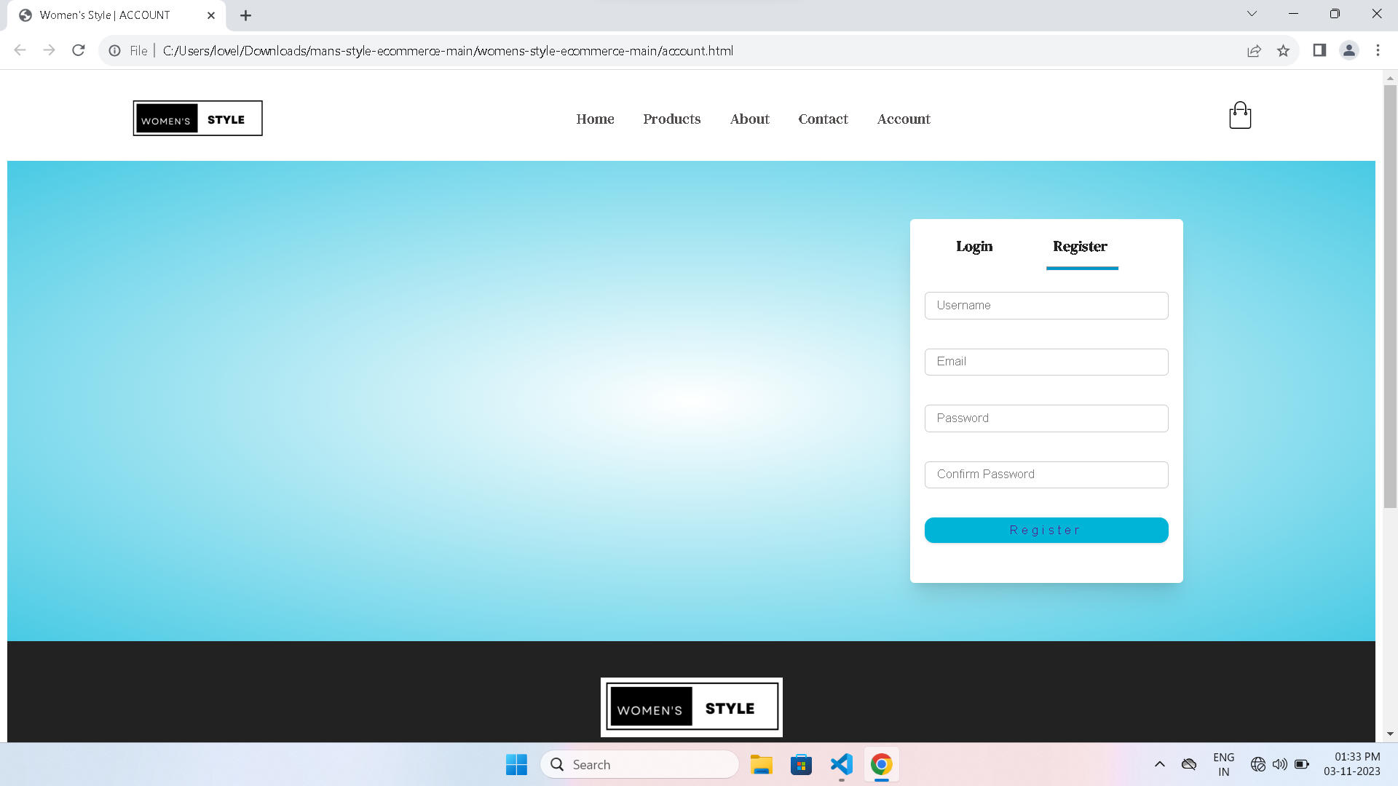
Login Page

Slide 8
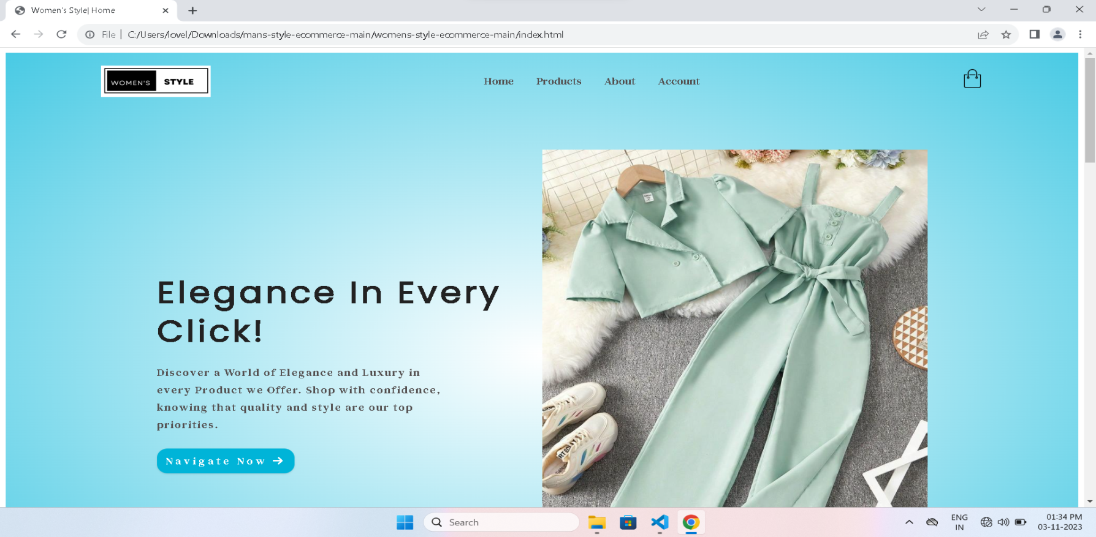
UI Interface

Slide 9

AssessmentꢀParameter
SetupꢀProjectꢀforꢀCalculatorꢀ
project
Setupꢀbasicꢀstructureꢀofꢀtext-
editorꢀproject
Createꢀaꢀmainꢀcomponentꢀwithꢀtheꢀ
outerꢀstructureꢀofꢀcalculator
Check-List
Createꢀmainꢀcomponentꢀwithꢀ
allꢀfeatureꢀbuttons
Createꢀaꢀbuttonꢀcomponentꢀ
withꢀonꢀclickꢀhandler
Createꢀaꢀjsonꢀobjectꢀtoꢀstoreꢀ
dataꢀforꢀtextꢀeditor
Createꢀaꢀ`ꢀevaluateExpresion`ꢀ
functionꢀtoꢀevaluateꢀvalue
Pushꢀbothꢀcodeꢀtoꢀgithub

Slide 10
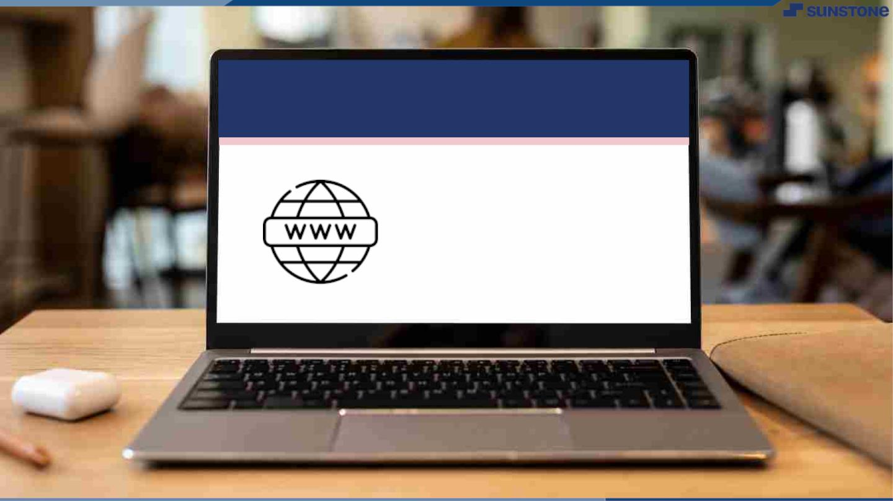
Submission Github
https://github.com/Durgalakshmi2002/Naan-Mudhalvan.git

Slide 11


